Slide 1
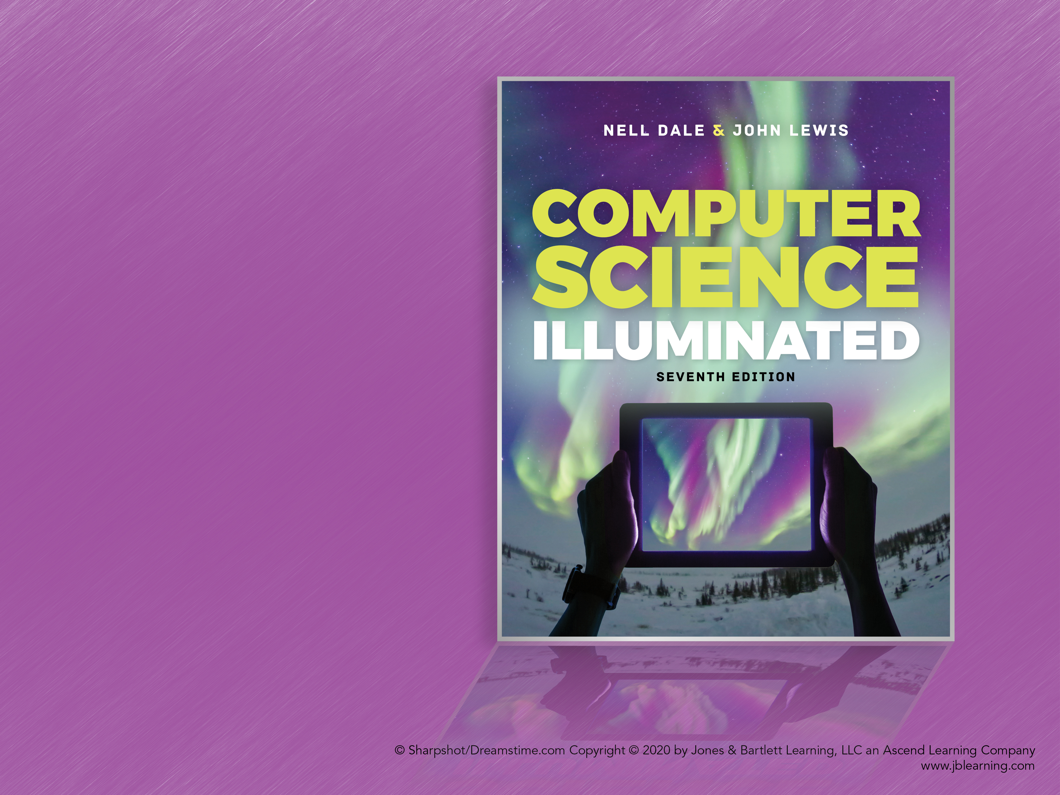
Chapter 3
Data Representation

Slide 2
Chapter Goals (1 of 2)
Distinguish between analog and digital information
Explain data compression and calculate compression ratios
Explain the binary formats for negative and floating-point values
Describe the characteristics of the ASCII and Unicode character sets
Perform various types of text compression

Slide 3
Chapter Goals (2 of 2)
Explain the nature of sound and its representation
Explain how RGB values define a color
Distinguish between raster and vector graphics
Explain temporal and spatial video compression

Slide 4
Data and Computers (1 of 2)
Computers are multimedia devices, dealing with a vast array of information categories
Computers store, present, and help us modify
Numbers
Text
Audio
Images and graphics
Video
All stored as binary digits (bits)

Slide 5
Data and Computers (2 of 2)
Data Compression
Reduction in the amount of space needed to store a piece of data or the bandwidth to transmit it
Compression Ratio
The size of the compressed data divided by the size of the original data
A data compression technique can be:
Lossless, which means the data can be retrieved without any loss of original information
Lossy, which means some information may be lost in the process of compression

Slide 6
Analog and Digital Information (1 of 4)
Computers are finite!
How do we represent an infinite world?
We represent enough of the world to satisfy our computational needs and our senses of sight and sound

Slide 7
Analog and Digital Information (2 of 4)
Information can be represented in one of two ways: analog or digital
Analog Data
A continuous representation, analogous to the actual information it represents
Digital Data
A discrete representation, breaking the information up into separate elements

Slide 8
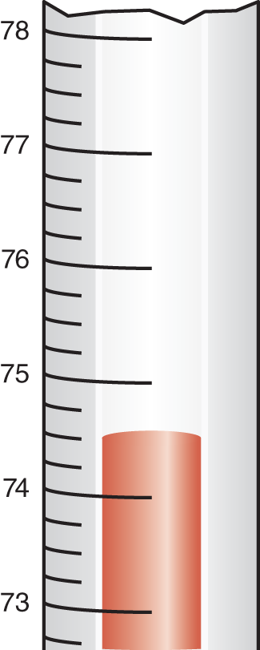
Analog and Digital Information (3 of 4)
A mercury thermometer
is an analog device
A mercury thermometer continually rises in direct proportion to the temperature

Slide 9
Analog and Digital Information (4 of 4)
Computers cannot work well with analog data, so we digitize the data
Digitize
Break data into pieces and represent those pieces separately
Why do we use binary to represent digitized data?

Slide 10
Electronic Signals (1 of 2)
Important facts about electronic signals:
An analog signal continually fluctuates in voltage up and down
A digital signal has only a high or low state, corresponding to the two binary digits
All electronic signals (both analog and digital) degrade as they move down a line
The voltage of the signal fluctuates due to environmental effects

Slide 11
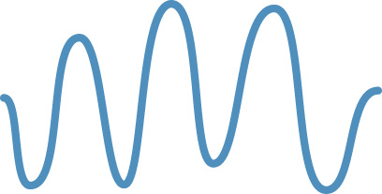


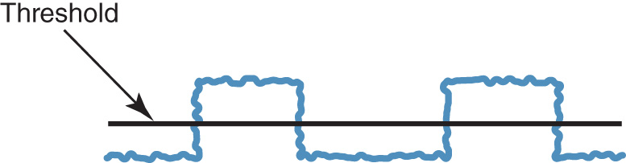
Electronic Signals (2 of 2)
An analog signal and a digital signal
Degradation of analog and digital signal
Periodically, a digital signal is reclocked to regain its original shape

Slide 12
Binary Representations (1 of 3)
Each bit can be either 0 or 1, so it can represent a choice between two possibilities (or “two things”)
Two bits can represent four things (Why? Hint: 00, 01, 10, 11.)
How many things can 3 bits represent?
How many things can 4 bits represent?
How many things can 8 bits represent?

Slide 13
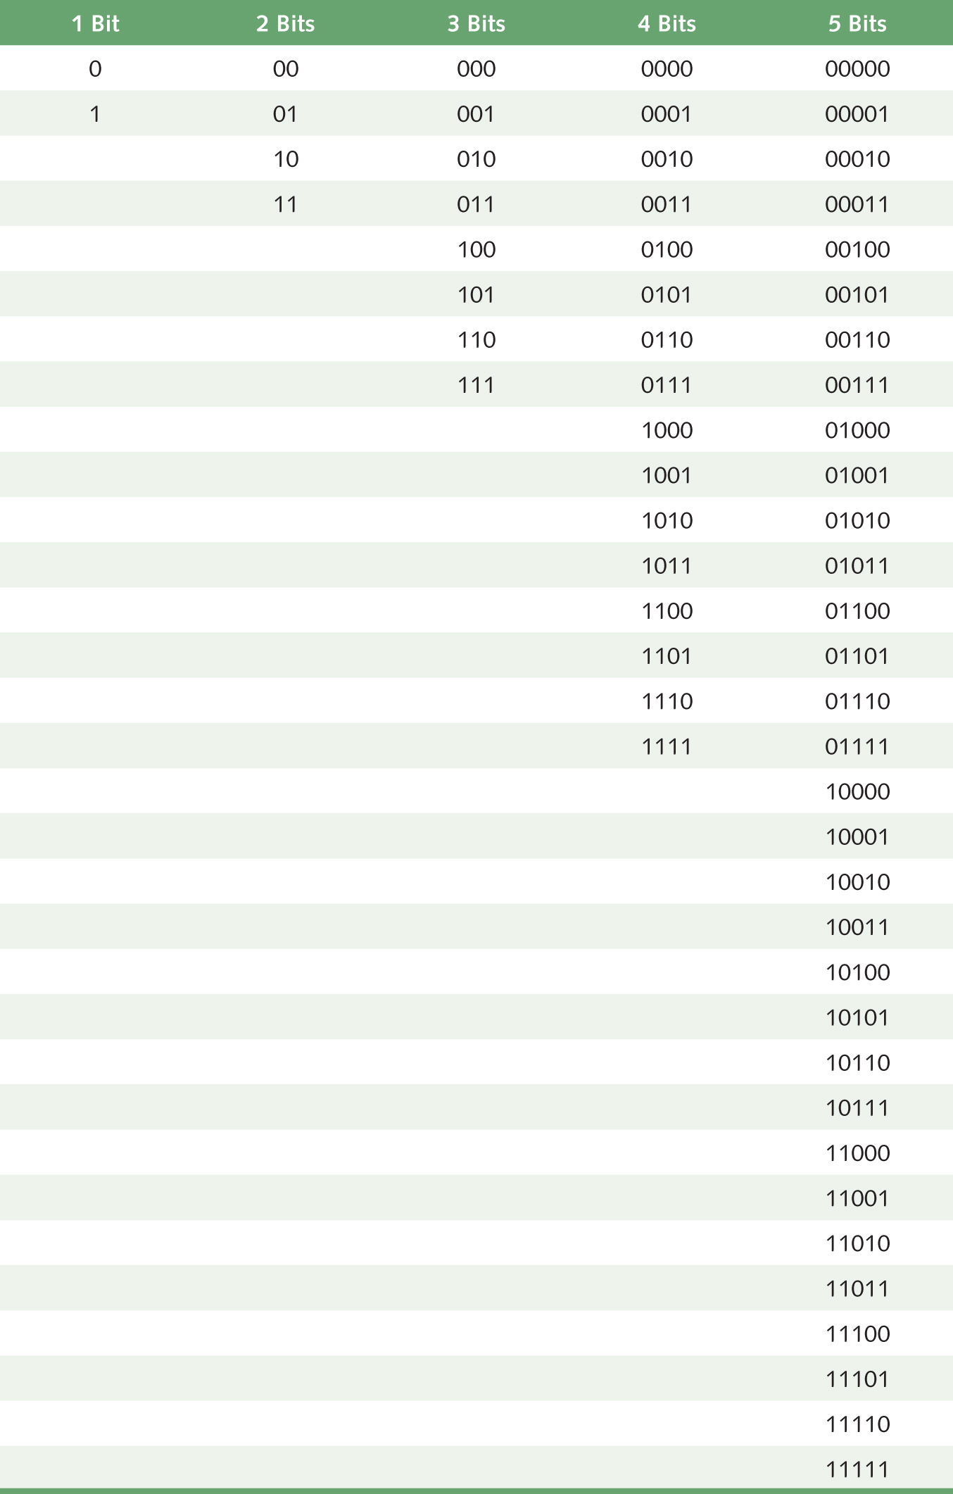
Binary Representations (2 of 3)
Bit combinations

Slide 14
Binary Representations (3 of 3)
How many bits are needed to represent 32 things? One hundred things?
How many things can n bits represent?
Why?
What happens every time you increase the number of bits by one?

Slide 15
Representing Natural Numbers
8-Bit Binary Representation | Natural Number
01111111 | 127
01111110 | 126
… | …
00000011 | 3
00000010 | 2
00000001 | 1
00000000 | 0
Convert to binary
Computers store data in fixed-size chunks, so we have leading zeroes
What do the integers include that the natural numbers do not?

Slide 16
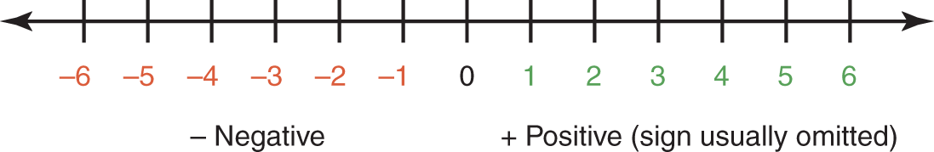
Representing Negative Values (1 of 8)
Signed-magnitude number representation
Used by humans
The sign represents the ordering (the negatives come before the positives in ascending order)
The digits represent the magnitude (the distance from zero)

Slide 17
Representing Negative Values (2 of 8)
Problem: Two zeroes (positive and negative)
No problem for humans, but would cause unnecessary complexity in computers
Solution: Represent integers by associating them with natural numbers
Half the natural numbers will represent themselves; the other half will represent negative integers

Slide 18
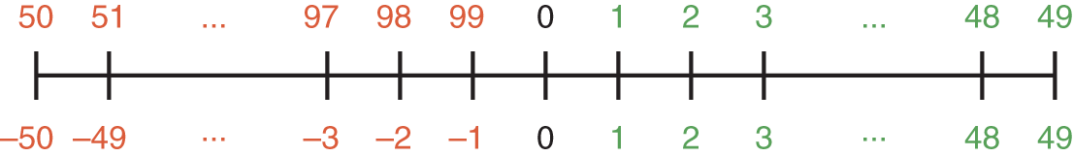
Representing Negative Values (3 of 8)
Using two decimal digits,
let 0 through 49 represent 0 through 49
let 50 through 99 represent –50 through –1

Slide 19
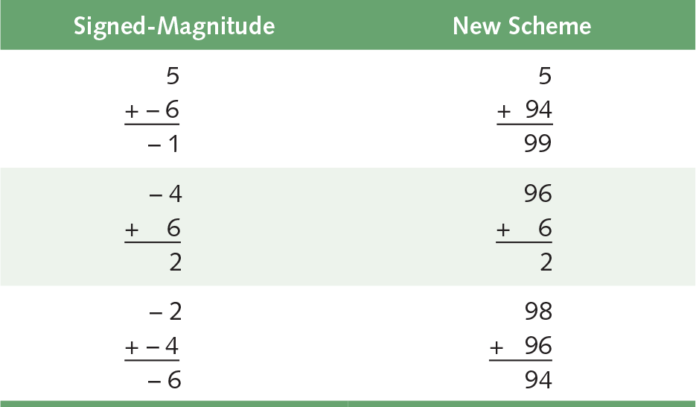
Representing Negative Values (4 of 8)
To perform addition, add the numbers and discard any carry to the hundreds digit
Now you try it
48 (signed-magnitude)
1
47
How does it work in
the new scheme?

Slide 20
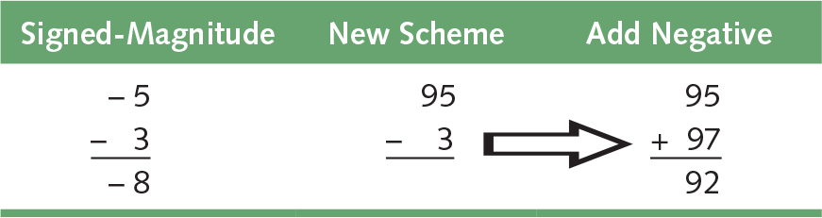
Representing Negative Values (5 of 8)
To perform subtraction, use A – B = A + (–B)
Add the negative of the second to the first
Try these:
4 4 –1
- 3 - (–3) - 2

Slide 21

Representing Negative Values (6 of 8)
Called ten’s complement representation, because we can use this formula to compute the representation of a negative number
For example, –3 is negative(3), so using two digits, its representation is
Negative(3) = 100 – 3 = 97
What do we get if we try this in binary?

Slide 22
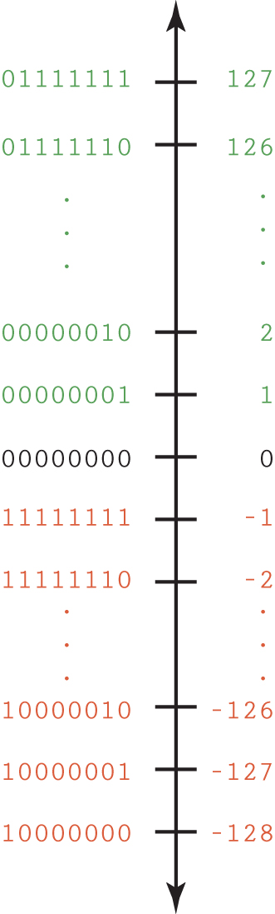
Representing Negative Values (7 of 8)
Two’s Complement
(The binary number line is easier to read when written vertically)
Remember our table showing how to represent natural numbers?
Do you notice something interesting about the left-most bit?

Slide 23
Representing Negative Values (8 of 8)
Addition and subtraction are the same as in ten’s complement arithmetic
–127 10000001
+ 1 00000001
–126 10000010
What if the computed value won't fit?

Slide 24
Number Overflow
If each value is stored using 8 bits, then 127 + 3 overflows:
01111111
+ 00000011
10000010
Apparently, 127 + 3 is –126. Remember when we said we would always fail in our attempt to map an infinite world onto a finite machine?
Most computers use 32 or 64 bits for integers, but there are always infinitely many that aren’t represented

Slide 25
Representing Real Numbers (1 of 5)
Real numbers are numbers with a whole part and a fractional part (either of which may be zero)
104.32
0.999999
357.0
3.14159
In decimal, positions to the right of the decimal point are the tenths, hundredths, thousandths, etc.:
10⁻¹, 10⁻² , 10⁻³ …

Slide 26
Representing Real Numbers (2 of 5)
Same rules apply in binary as in decimal
Radix point is general term for “decimal point”
Positions to the right of the radix point in binary:
2⁻¹ (halves position)
2⁻² (quarters position)
2⁻³ (eighths position)
…

Slide 27
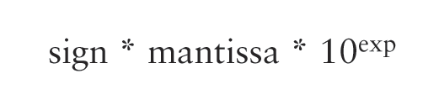
Representing Real Numbers (3 of 5)
A real value in base 10 can be defined by the following formula where the mantissa is an integer:
This representation is called floating point because the radix point “floats”
In analogy to the fixed number of bits that computers use to represent integers, we’ll treat the mantissa as having a fixed number of digits

Slide 28
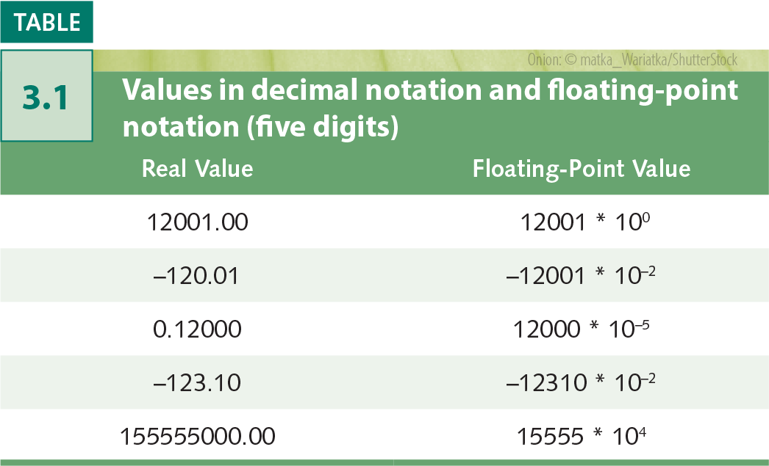
Representing Real Numbers (4 of 5)
Floating-point in binary:
sign * mantissa * 2^{exp}
Only the base value is
different from decimal
Fundamentally, the floating point used by computers is very similar, but uses complicated tricks to represent more numbers and improve efficiency
Values in decimal notation and floating-point notation. (five digits)

Slide 29
Representing Real Numbers (5 of 5)
Scientific Notation
A form of floating-point representation in which the decimal point is kept to the right of the leftmost digit
12001.32708 is 1.200132708E+4 in scientific notation (E+4 is how computers display x10⁴)
What is 123.332 in scientific notation?
What is 0.0034 in scientific notation?

Slide 30
Representing Text
What must be provided to represent text?
The number of characters to represent is finite (whew!), so list them all and assign each a binary string
Character Set
A list of characters and the codes used to represent each one
Computer manufacturers agreed to standardize

Slide 31
The ASCII Character Set
ASCII stands for American Standard Code for Information Interchange
ASCII originally used seven bits to represent each character, allowing for 128 unique characters
Later extended ASCII evolved so that all eight bits were used
How many characters could be represented?

Slide 32
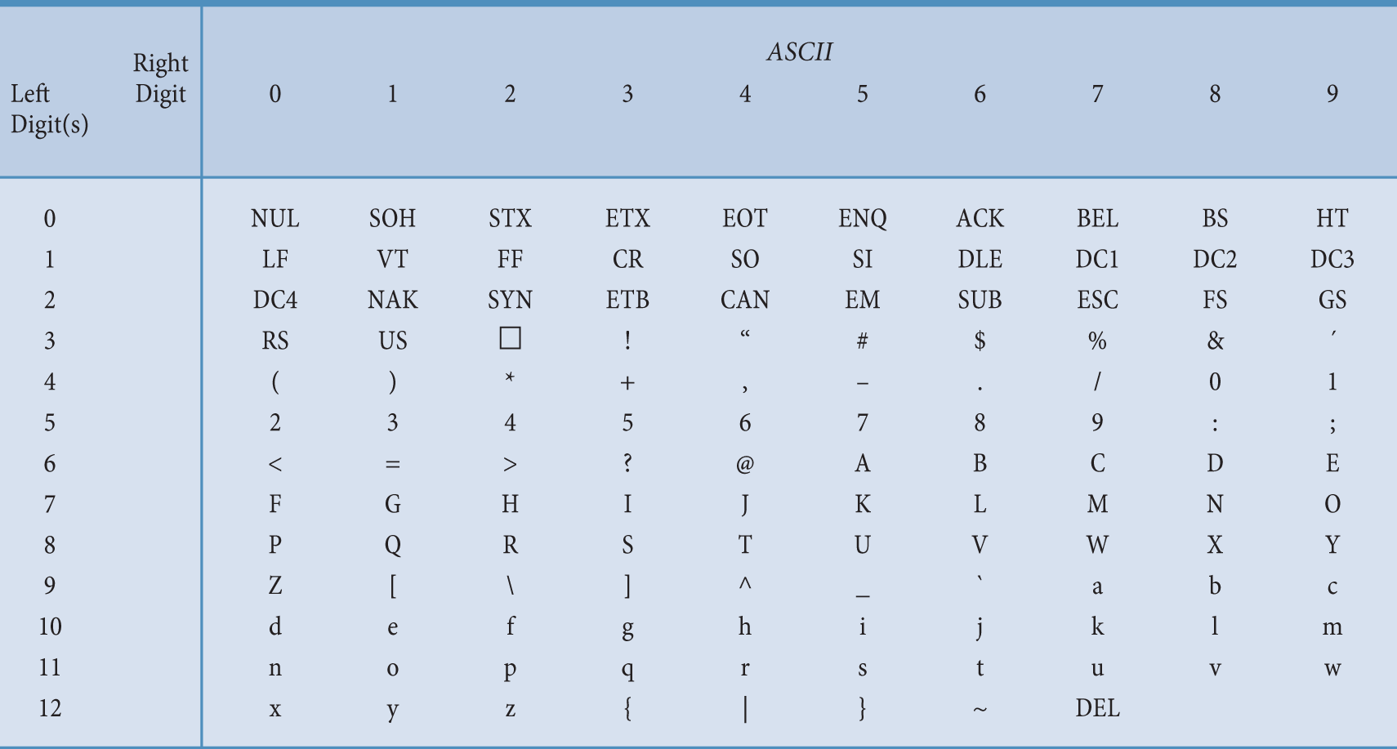
ASCII Character Set Mapping
The ASCII character set

Slide 33
The ASCII Character Set
The first 32 characters in the ASCII character chart do not have a simple character representation to print to the screen.
What do you think they are used for?

Slide 34
The Unicode Character Set (1 of 2)
Extended ASCII is not enough for international use
One Unicode mapping uses 16 bits per character
How many characters can this mapping represent?
The first 256 characters correspond exactly to the extended ASCII character set

Slide 35
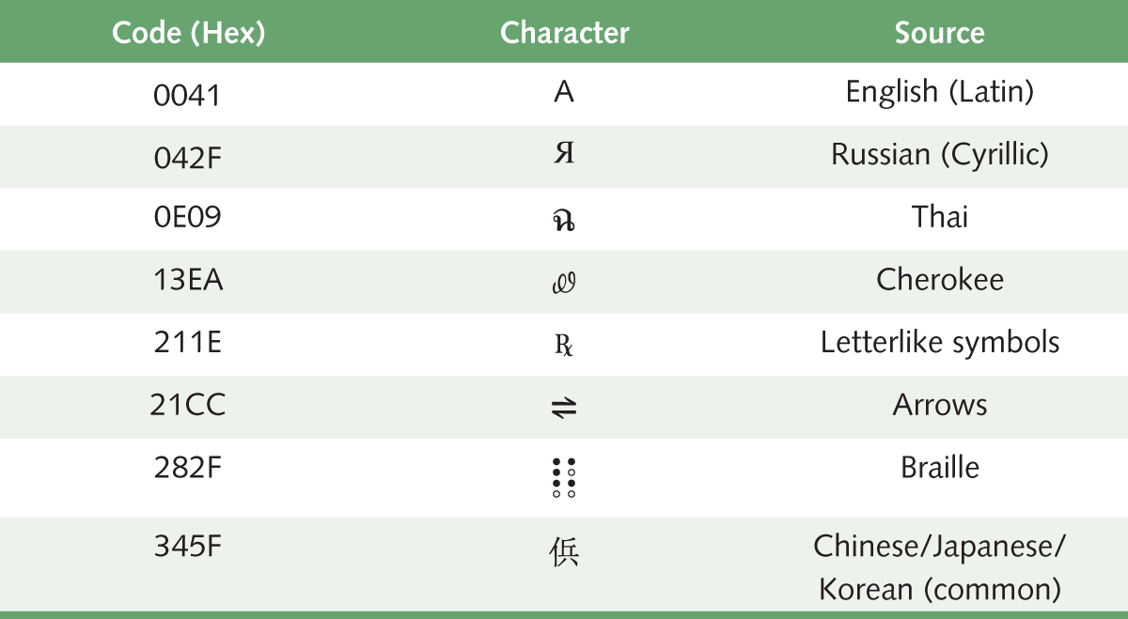
The Unicode Character Set (2 of 2)
A few characters in the Unicode character set

Slide 36
Text Compression
If storage or bandwidth is scarce, how can we store and transmit data more efficiently?
Compression is most useful for big files (e.g., audio, graphics, video, and scientific data)
Text files are typically pretty small, but as an illustration, can we use less than 16 bits per character without losing information?
Lossless compression techniques include:
Keyword encoding
Run-length encoding
Huffman encoding

Slide 37
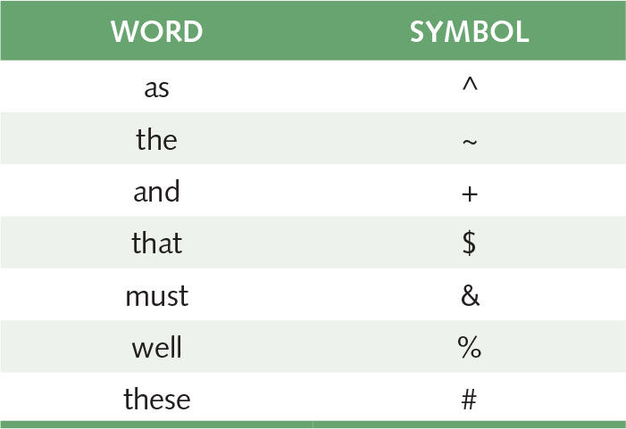
Keyword Encoding (1 of 4)
Replace frequently used patterns of text with a single special character, such as:

Slide 38
Keyword Encoding (2 of 4)
Given the following paragraph,
We hold these truths to be self-evident, that all men are created equal, that they are endowed by their Creator with certain unalienable Rights, that among these are Life, Liberty and the pursuit of Happiness. — That to secure these rights, Governments are instituted among Men, deriving their just powers from the consent of the governed, — That whenever any Form of Government becomes destructive of these ends, it is the Right of the People to alter or to abolish it, and to institute new Government, laying its foundation on such principles and organizing its powers in such form, as to them shall seem most likely to effect their Safety and Happiness.

Slide 39
Keyword Encoding (3 of 4)
The encoded paragraph is
We hold # truths to be self-evident, $ all men are created equal, $ ~y are endowed by ~ir Creator with certain unalienable Rights, $ among # are Life, Liberty + ~ pursuit of Happiness. — $ to secure # rights, Governments are instituted among Men, deriving ~ir just powers from ~ consent of ~ governed, — $ whenever any Form of Government becomes destructive of # ends, it is ~ Right of ~ People to alter or to abolish it, + to institute new Government, laying its foundation on such principles + organizing its powers in such form, ^ to ~m shall seem most likely to effect ~ir Safety + Happiness.

Slide 40
Keyword Encoding
What did we save?
Original paragraph:
656 characters
Encoded paragraph:
596 characters
Characters saved:
60 characters
Compression ratio:
596/656 = 0.9085
Could we use this substitution chart for all text?

Slide 41
Run-Length Encoding (1 of 2)
In some types of data files, a single value may be repeated over and over again in a long sequence
Replace a repeated sequence with
a flag
the repeated value
the number of repetitions
*n8
* is the flag
n is the repeated value
8 is the number of times n is repeated

Slide 42
Run-Length Encoding (2 of 2)
Original text
bbbbbbbbjjjkllqqqqqq+++++
Encoded text
*b8jjjkll*q6*+5 (Why isn't J encoded? L?)
The compression ratio is 15/25 or .6
Encoded text
*x4*p4l*k7
Original text
xxxxpppplkkkkkkk
This type of repetition doesn’t occur in English text. Can you think of a situation where it might occur?

Slide 43
Huffman Encoding (1 of 5)
The characters “X” and “z” occur much less frequently than “e” and the space character, for example.
What if we could use fewer bits for common characters in exchange for using more bits for uncommon characters?
This is the idea behind prefix codes, including Huffman codes

Slide 44
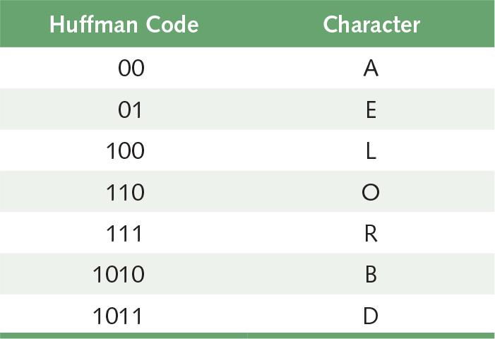
Huffman Encoding (2 of 5)
“ballboard” would be
10100010 01001010 11000111 1011xxxx
compression ratio 4 bytes / 18 bytes = 0.222 assuming 16-bit Unicode
Try “roadbed”
Note: Only the part of the code needed to encode “ballboard” and “roadbed” is shown. In the full code, every character would have an encoding, and the most common characters would have the shortest encodings.

Slide 45
Huffman Encoding (3 of 5)
Huffman encoding is an example of prefix coding: no character's bit string is the prefix of any other character's bit string
To decode
Look for match left to right, bit by bit
Record letter when a match is found
Begin where you left off, going left to right

Slide 46
Huffman Encoding (4 of 5)
Try it!
Decode
1011111001010

Slide 47
Huffman Encoding (5 of 5)
Technique for determining codes guarantees the prefix property of the codes
Two types of codes based on where the frequencies come from:
General, based on use of letters in English (Spanish, ….)
Specialized, based on text itself or specific types of text

Slide 48
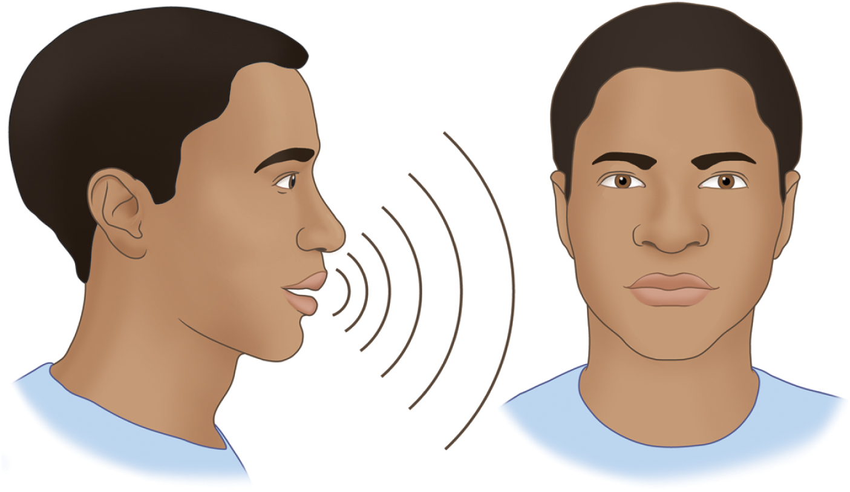
Representing Audio Information (1 of 5)
A sound wave vibrates our eardrums
We perceive sound when a series of air pressure waves vibrate a
membrane in our ear, which sends signals to our brain.

Slide 49
Representing Audio Information (2 of 5)
Your parents may use a “stereo” to listen to music at home. It sends an electrical signal to each speaker, which then vibrates to produce sound. Your MP3 player and ear buds do the same thing.
The signal controls the motion of a membrane in the speaker, which in turn creates the pressure waves that reach our ears.
Thus, the signal is an analog representation of the sound wave.

Slide 50
Representing Audio Information (3 of 5)
Digitize the signal by:
Sampling: Periodically measure the voltage
Quantization: Represent the voltage as a number using a finite number of bits
How often should we sample?
A sampling rate of about 40,000 times per second is enough to create a reasonable sound reproduction

Slide 51
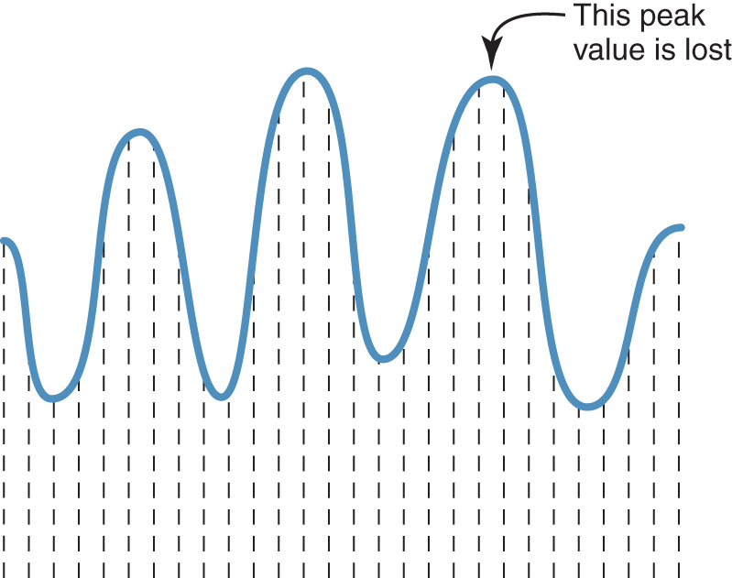
Representing Audio Information (4 of 5)
Some data
is lost, but a
reasonable
sound is
reproduced
Sampling an audio signal

Slide 52
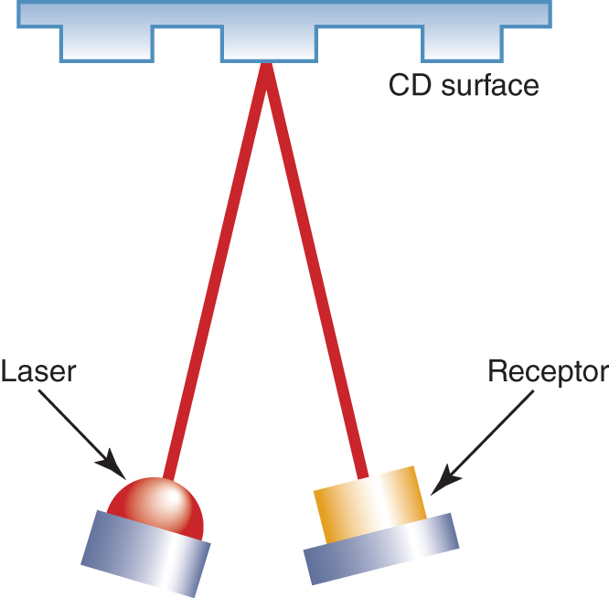
Representing Audio Information (5 of 5)
CDs store audio (or other) information digitally
Pits (reflect poorly)
Lands (reflect well)
Read by low-intensity laser
Receptor converts reflections into binary digits
Bit string represents audio signal
A CD player reading binary data

Slide 53
Audio Formats
Audio formats:
WAV, AU, AIFF, VQF, and MP3
Use various compression techniques
MP3 is dominant
MPEG-2, audio layer 3 file
MPEG = Motion Picture Experts Group
Based on studies of interrelation between ear and brain, discards frequency information that isn’t perceived by humans (science!)
Additional compression by a form of Huffman encoding
Is this a lossy or lossless compression (or both)?

Slide 54
Representing Images and Graphics (1 of 6)
Color
We take it for granted, but what is it really?
Retinas of our eyes have three types of photoreceptor cone cells
Each type responds to a different set of frequencies of light
Our brain translates that response into a perception of red, green, or blue

Slide 55
Representing Images and Graphics (2 of 6)
Color is expressed as an RGB (red-green-blue) value – three numbers that indicate the relative contribution of each of these three primary colors.
An RGB value of (255, 255, 0) maximizes the contribution of red and green, and minimizes the contribution of blue, which results in a bright yellow.

Slide 56
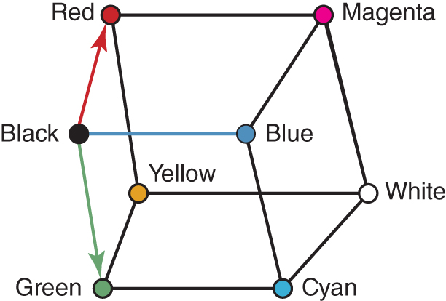
Representing Images and Graphics (3 of 6)
A three-dimensional color space

Slide 57
Representing Images and Graphics (4 of 6)
Color depth
The amount of data that is used to represent a color
HiColor
A 16-bit color depth: 5 bits used for each number in an RGB value with the extra bit sometimes used to represent transparency
TrueColor
A 24-bit color depth: 8 bits used for each number in an RGB value

Slide 58
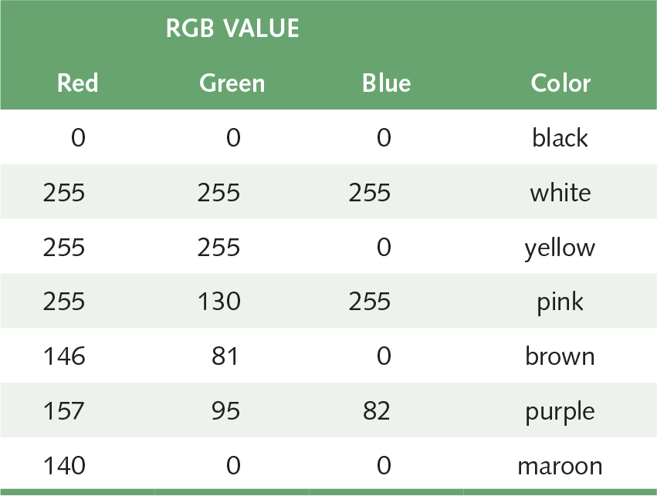
Representing Images and Graphics (5 of 6)
A few TrueColor
RGB values and
the colors they
represent

Slide 59
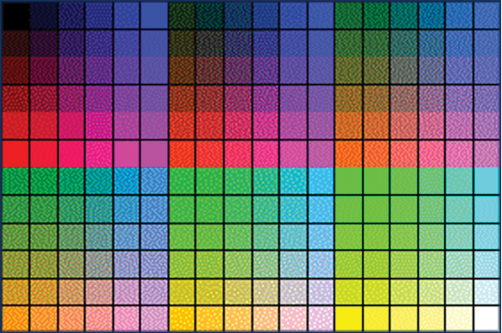
Representing Images and Graphics (6 of 6)
A color palette is a set of colors; for example:
Colors supported by a monitor
Web-safe colors for use with Internet browsers
Colors from which user can choose
Colors used in an image
A restricted color palette

Slide 60
Digitized Images and Graphics (1 of 5)
Pixels (picture elements)
Dots of color in image (or display device)
Resolution
Number of pixels in image (or device)
Raster graphics
Treat image as collection of pixels
Most common formats: BMP, GIF, PNG, and JPEG
Vector graphics
Treat image as collection of geometric objects
Most important formats: Flash and SVG

Slide 61
Digitized Images and Graphics (2 of 5)
BMP (bitmap)
TrueColor color depth, or less to reduce file size
Well suited for compression by run-length encoding
GIF (indexed color)
File explicitly includes palette of 256 or fewer colors
Each pixel thus requires only 8 or fewer bits
Animated GIFs are short sequences of images
PNG (Portable Network Graphics)
Intended to replace GIFs
Greater compression with wider range of color depths
No animation

Slide 62
Digitized Images and Graphics (3 of 5)
JPEG (Joint Photographic Experts Group)
Averages hues over short distances
Why? Human vision tends to blur colors together within small areas (science!)
How? Transform from the spatial domain to the frequency domain, then discard high-frequency components (math!)
Sound familiar? Essentially the same idea used in MP3
Adjustable degree of compression
Raster graphics recap: BMP, GIF, PNG, and JPEG
Which use lossless compression? Lossy?
Which would you use for line art? For a color photograph?

Slide 63
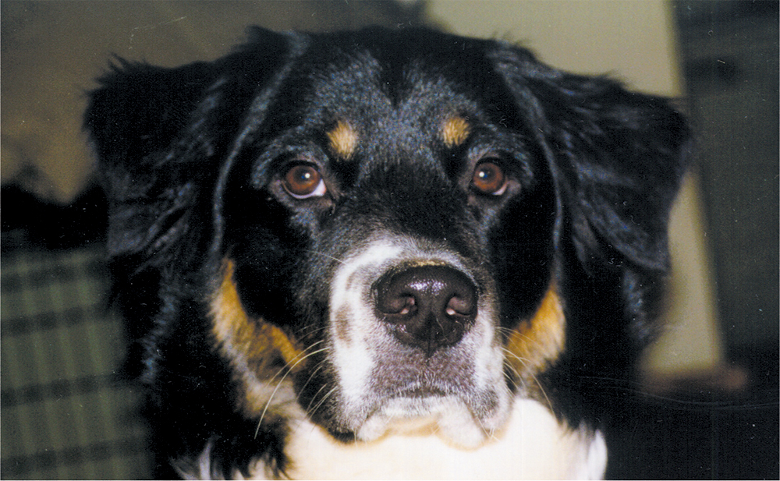
Digitized Images and Graphics (4 of 5)
Whole
picture
Courtesy of Amy Rose.
A digitized picture composed of many individual pixels

Slide 64
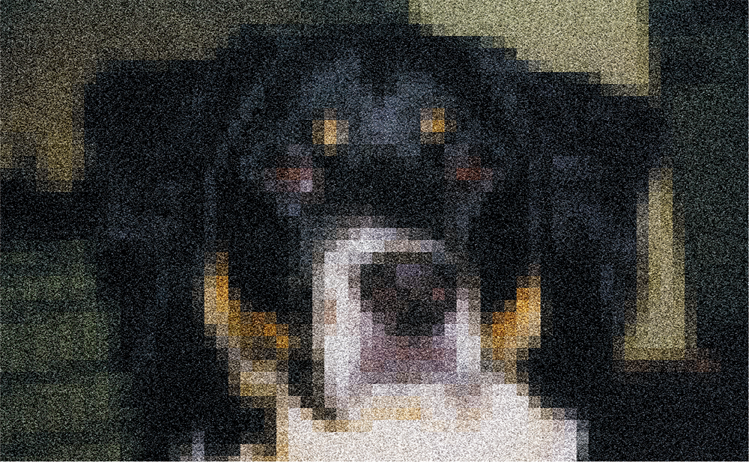
Digitized Images and Graphics (5 of 5)
Magnified portion
of the picture
See the pixels?
Each pixel of the image now fills a block of screen pixels.
Courtesy of Amy Rose.
A digitized picture composed of many individual pixels

Slide 65
Metadata
An image is often stored with metadata – data about data
Such metadata may include:
Date and time the image was created
Size and resolution of the image
Location the photo was taken
Creator of the image
Copyright information

Slide 66
Vector Graphics (1 of 2)
Vector Graphics
A format that describes an image in terms of lines and geometric shapes
A vector graphic is a series of commands that describe shapes using mathematical properties (e.g., direction, length, thickness, color)
For some types of images, the file sizes can be smaller than with raster graphics because not every pixel is described

Slide 67
Vector Graphics (2 of 2)
The good side and the bad side…
Vector graphics can be resized mathematically and changes can be calculated dynamically as needed.
Vector graphics are good for line art (e.g., diagrams) and cartoon-style drawings.
Vector graphics are not good for representing images of the real world.

Slide 68
Representing Video (1 of 2)
Video codec COmpressor/DECompressor Methods used to shrink the size of a movie to allow it to be played on a computer or over a network
Almost all video codecs use lossy compression to minimize the huge amounts of data associated with video

Slide 69
Representing Video (2 of 2)
Temporal Compression
A technique based on differences between consecutive frames: If most of an image in two frames has not changed, why should we waste space duplicating information?
Spatial Compression
A technique based on removing repetitive information within a frame: This problem is essentially the same as that faced when compressing still images.

Slide 70
Ethical Issues
The Fallout from Snowden’s Revelations
What government program was revealed by the documents that Edward Snowden leaked? When was this program first authorized? What led to President Obama announcing that the program would be scaled back? Do you think Snowden is a criminal? A hero? A traitor? A patriot?

Slide 71
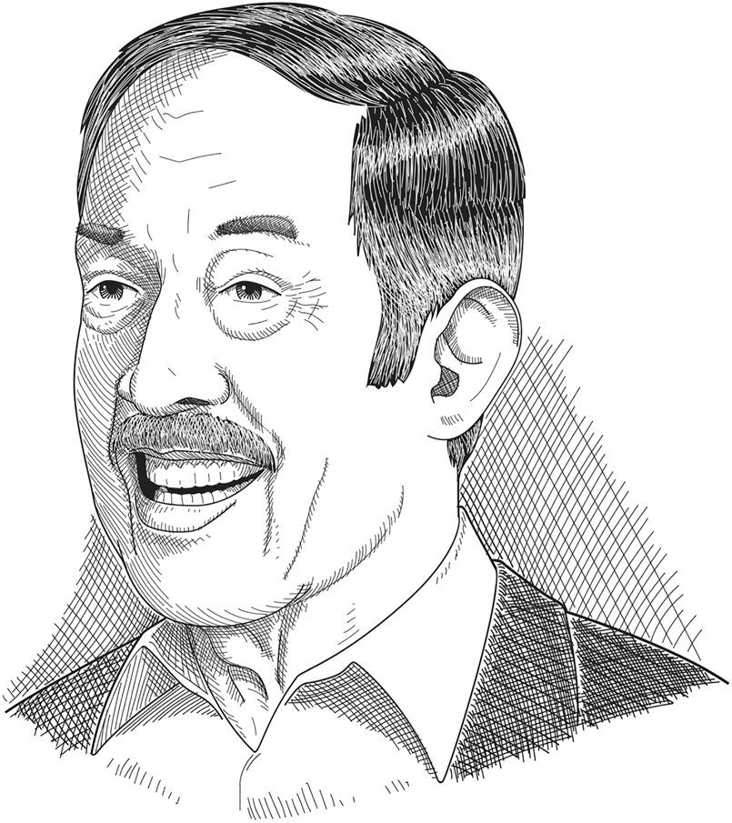
Who Am I?
I was very
versatile.
Can you name
four items on my
resume?

Slide 72
Do You Know?
How many computer character sets existed
in 1960?
What happened between 10/24/02 and
10/26/02 to guests of Holiday Inn, Holiday Inn Express, or Crown Plaza?
What criteria are used in Japan’s phone answering competition?
Who described the telegraph as a kind of
very long cat?

